Slide 1
Artificial intelligence & machine learning
Topic: Knowledge Representation Techniques

Slide 2
introduction
We, humans, are good at reasoning, understanding, analyzing, and interpreting what we are seeing in our daily life. We know how to react and respond to the situation we are going through. But how to make machines perform similar actions?
Here comes the knowledge representation in AI that equips the machines to perform understanding and interpreting the queries of the real world.
Knowledge Representation in AI is the study of how to equip intelligent machines with beliefs, intentions, and judgments to express according to the situations through automated reasoning.

Slide 3
What is Knowledge Representation?
Knowledge Representation in AI describes the representation of knowledge. Basically, it is a study of how the beliefs, intentions, and judgments of an intelligent agent can be expressed suitably for automated reasoning.
One of the primary purposes of Knowledge Representation includes modeling intelligent behavior for an agent.
Knowledge Representation and Reasoning (KR, KRR) represents information from the real world for a computer to understand and then utilize this knowledge to solve complex real-life problems like communicating with human beings in natural language.
Knowledge representation in AI is not just about storing data in a database, it allows a machine to learn from that knowledge and behave intelligently like a human being.

Slide 4
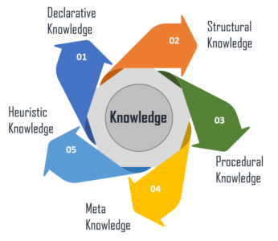
Different Types of Knowledge

Slide 5
Different types of Knowledge…
Declarative Knowledge – It includes concepts, facts, and objects and expressed in a declarative sentence.
Structural Knowledge – It is a basic problem-solving knowledge that describes the relationship between concepts and objects.
Procedural Knowledge – This is responsible for knowing how to do something and includes rules, strategies, procedures, etc.
Meta Knowledge – Meta Knowledge defines knowledge about other types of Knowledge.
Heuristic Knowledge – This represents some expert knowledge in the field or subject.

Slide 6
Techniques of knowledge representation
Three major techniques of Knowledge Representation:
Logical Representation
Semantic Network Representation
Frame Representation

Slide 7
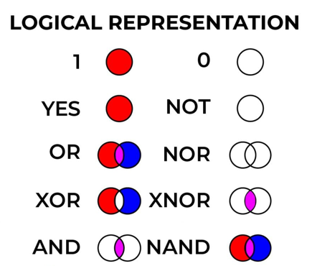
Logical Representation
It is the most basic form of representing knowledge to machines where a well-defined syntax with proper rules is used.
This syntax needs to have no ambiguity in its meaning and must deal with prepositions.
Thus, this logical form of presentation acts as communication rules and is why it can be best used when representing facts to a machine.

Slide 8
Logical Representation…
Logical representation is a language with some definite rules which deals with propositions and has no ambiguity in representation.
It represents a conclusion based on various conditions and lays down some important communication rules.
Logical representation can be categorized into mainly two logics:
Propositional Logic
First Order Logic

Slide 9
Logical Representation…
Propositional Logic, also known as propositional calculus or statement logic, is a formal system of logic that deals with the relationships between propositions, which are statements that are either true or false. Propositional logic is based on the Boolean system, which means that propositions are evaluated as either true or false. In propositional logic, propositions are combined using logical connectives such as "and", "or", and "not", and the resulting compound propositions can also be evaluated as true or false based on the truth values of their component propositions.
First-order logic (FOL), also known as first-order predicate calculus (FOPC) or first-order logic with identity, is an extension of propositional logic that allows for the representation of more complex relationships between objects. In FOL, propositions are constructed using predicates, which are statements that describe properties or relations between objects, and quantifiers, which specify the scope of the variables in the proposition.

Slide 10
Logical Representation…
Advantages:
Logical representation helps to perform logical reasoning.
This representation is the basis for the programming languages.
Disadvantages:
Logical representations have some restrictions and are challenging to work with.
This technique may not be very natural, and inference may not be very efficient.

Slide 11
Propositional Logic
Represent real world facts as logical propositions written as Well Formed Formula (Wffs).
Simple to deal with.
A decision procedure exists for it.
Facts Propositional logic
it is raining RAINING
it is sunny SUNNY
it is windy WINDY
if it is raining, then it is not sunny RAINING → ¬ SUNNY

Slide 12
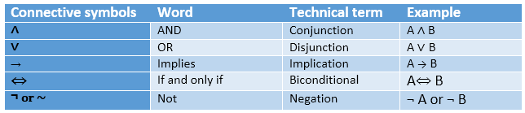
summarized table for Propositional Logic Connectives

Slide 13
Propositional Logic
The propositional logic symbols and sentences:
If S is a sentence, ¬ S is a sentence (negation) (¬S is true iff S is false )
If S1 and S2 are sentences, S1 ∧ S2 is a sentence (conjunction) S₁∧S₂ is true iff S₁ is true and S₂ is true
If S1 and S2 are sentences, S1 ∨ S2 is a sentence (disjunction) S₁∨S₂ is true iff S₁ is true or S₂ is true
If S1 and S2 are sentences, S1 ⇒ S2 is a sentence (implication) S1⇒S2 is true iff S₁ is false or S₂ is true i.e, S1 ⇒ S2 is false iff, S1 is true and S2 is false
If S1 and S2 are sentences, S1 ⇔ S2 is a sentence (bi-conditional) S₁⇔S₂ is true iff S₁ ⇒ S₂ is true and S₂ ⇒ S₁ is true

Slide 14
Logical Connectives:
Negation: A sentence such as ¬ P is called negation of P. A literal can be either Positive literal or negative literal.
Conjunction: A sentence which has ∧ connective such as, P ∧ Q is called a conjunction. Example: Rohan is intelligent and hardworking. It can be written as, P= Rohan is intelligent, Q= Rohan is hardworking. → P∧ Q.
Disjunction: A sentence which has ∨ connective, such as P ∨ Q. is called disjunction, where P and Q are the propositions. Example: "Ritika is a doctor or Engineer", Here P= Ritika is Doctor. Q= Ritika is Doctor, so we can write it as P ∨ Q.
Implication: A sentence such as P → Q, is called an implication. Implications are also known as if-then rules. It can be represented as: If it is raining, then the street is wet. Let P= It is raining, and Q= Street is wet, so it is represented as P → Q
Biconditional: A sentence such as P⇔ Q is a Biconditional sentence, example: If I am breathing, then I am alive P= I am breathing, Q= I am alive, it can be represented as P ⇔ Q

Slide 15
Logical equivalence
Commutativity:
P∧ Q= Q ∧ P, or
P ∨ Q = Q ∨ P.
Associativity:
(P ∧ Q) ∧ R= P ∧ (Q ∧ R),
(P ∨ Q) ∨ R= P ∨ (Q ∨ R)
Identity element:
P ∧ True = P,
P ∨ True= True.
Distributive:
P∧ (Q ∨ R) = (P ∧ Q) ∨ (P ∧ R).
P ∨ (Q ∧ R) = (P ∨ Q) ∧ (P ∨ R).
DE Morgan's Law:
¬ (P ∧ Q) = (¬P) ∨ (¬Q)
¬ (P ∨ Q) = (¬ P) ∧ (¬Q).
Double-negation elimination:
¬ (¬P) = P.

Slide 16
Logical equivalence…
Name | Equivalences
Identity | p ∧ T ≡ p, p ∨ F ≡ p
Domination | p ∨ T ≡ T, p ∧ F ≡ F
Idempotent | p ∧ p ≡ p, p ∨ p ≡ p
Double Negation | ¬(¬p) ≡ p
Commutative | p ∨ q ≡ q ∨ p , p ∧ q ≡ q ∧ p
Associative | (p ∨ q) ∨ r ≡ p ∨ (q ∨ r) , (p ∧ q) ∧ r ≡ p ∧ (q ∧ r)
Distributive | p ∨ (q ∧ r) ≡ (p ∨ q) ∧ (p ∨ r), p ∧ (q ∨ r) ≡ (p ∧ q) ∨ (p ∧ r)
De Morgan's Law | ¬(p ∧ q)≡ ¬p ∨ ¬q, ¬(p ∨ q) ≡ ¬p ∧ ¬q
Absorption | p ∨ (p ∧ q)≡p, p ∧ (p ∨ q) ≡ p
Negation | p ∨ ¬p ≡ T, p ∧ ¬p ≡ F

Slide 17
Limitations of Propositional Logic
If you want to represent complicated sentences or natural language statements, PL is not sufficient.
We cannot represent relations like ALL, some, or none with propositional logic. Example:
All the girls are intelligent.
Some apples are sweet.
There is very limited expressive power in PL, so we use FOL instead
Example:
All men are mortal MORTALMAN
fails to capture the relationship between individual being a man and that individual being a mortal.

Slide 18
First Order Logic
First-order logic is another way of knowledge representation in artificial intelligence. It is an extension to propositional logic.
FOL is sufficiently expressive to represent the natural language statements in a concise way.
First-order logic is also known as Predicate logic or First-order predicate logic. First-order logic is a powerful language that develops information about the objects in a more easy way and can also express the relationship between those objects.

Slide 19
Quantifiers in First-order logic
These are the symbols that permit to determine or identify the range and scope of the variable in the logical expression. There are two types of quantifier:
Universal Quantifier, (for all, everyone, everything)
Existential quantifier, (for some, at least one).
The is represented by a symbol ∀, which resembles an inverted A. Universal quantifier
Existential quantifiers are denoted by the logical operator ∃, which resembles as inverted E. When it is used with a predicate variable then it is called as an existential quantifier.

Slide 20
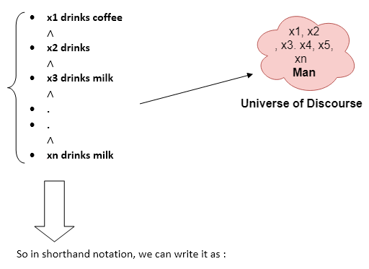
Universal Quantifier
If x is a variable, then ∀x is read as:
For all x
For each x
For every x.
Example:
All man drink coffee.
Let a variable x which refers to a man, so all x can be represented as: ∀x man(x) → drink (x, coffee)
It will be read as: There are all x where x is a man who drink coffee.
∀x man(x) → drink (x, coffee).

Slide 21
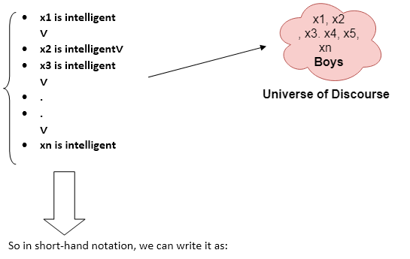
Existential Quantifier
If x is a variable, then existential quantifier will be ∃x or ∃(x). And it will be read as:
There exists a 'x.'
For some 'x.'
For at least one 'x.'
Example:
Some boys are intelligent.
∃x: boys(x) ∧ intelligent(x)
It will be read as: There are some x where x is a boy who is intelligent.
∃x: boys(x) ∧ intelligent(x)

Slide 22
First Order Logic
Use of predicate logic as a way of representing knowledge:
1.Marcus was a man man(Marcus)
2.Marcus was a Pompeian Pompeian(Marcus)
3.All Pompeians were Romans ∀x: Pompeian(x) → Roman(x)
4.Casear was a ruler ruler(Casear)
5.All Romans are either loyal to Caesar or hated him
∀x: roman(x) → loyalto(x,Caesar) ∨ hate(x,Caesar)
6.Everyone is loyal to someone ∀x: ∃y: loyalto(x,y)
7.people only try to assassinate rulers they are not loyal to
∀x: ∀y: person(x) ^ ruler(y) ^ tryassassinate(x,y) → ¬loyalto(x,y)
8.Marcus tried to assassinate Caesar tryassassinate(Marcus,Caesar)

Slide 23
Semantic Network Representation
Semantic networks are alternative of predicate logic for knowledge representation.
In Semantic networks, we can represent our knowledge in the form of graphical networks. This network consists of nodes, representing objects and arcs which describe the relationship between those objects
This representation consist of mainly two types of relations:
IS-A relation (Inheritance)
Kind-of-relation

Slide 24
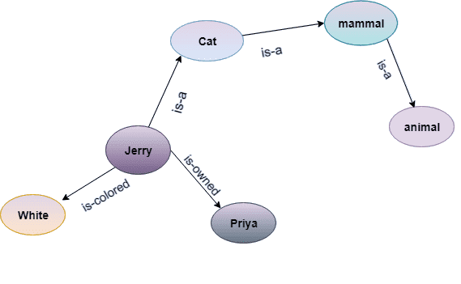
Semantic Network Representation
Statements:
Jerry is a cat.
Jerry is a mammal
Jerry is owned by Priya.
Jerry is white colored.
All Mammals are animal.
Mammal
Cat
Is-a
Is-a
Rubi
Animal
Is-colored
Is-owned
White
Jack

Slide 25
Semantic Network Representation…
Advantages:
Semantic networks are a natural representation of knowledge.
Also, it conveys meaning in a transparent manner.
These networks are simple and easy to understand.
Disadvantages:
Semantic networks take more computational time at runtime.
Also, these are inadequate as they do not have any equivalent quantifiers.
These networks are not intelligent and depend on the creator of the system.

Slide 26
Frame Representation
A frame is a record like structure which consists of a collection of attributes and its values to describe an entity in the world. Frames are the AI data structure which divides knowledge into substructures by representing stereotypes situations. It consists of a collection of slots and slot values. These slots may be of any type and sizes. Slots have names and values which are called facets.
The various aspects of a slot is known as Facets. Facets are features of frames which enable us to put constraints on the frames.
A frame is also known as slot-filter knowledge representation in artificial intelligence.

Slide 27
Frame Representation: example
Example:
Let's take an example of a frame for a book:
Slots | Filters
Title | Artificial Intelligence
Genre | Computer Science
Author | Peter Norvig
Edition | Third Edition
Year | 1996
Page | 1152

Slide 28
FRAME Representation…
Advantages of frame representation:
By grouping related facts, the frame knowledge representation makes programming easier.
Many AI applications employ the frame representation because it is rather flexible.
Adding slots for additional attributes and relations is a breeze.
It's simple to add default data and look for missing variables.
The frame representation is simple to grasp and visualize.
Disadvantages of frame representation:
The inference mechanism in a frame system is difficult to process.
Frame representation does not allow for a smooth progression of the inference procedure.
Frame representation has a much generalized approach.

Slide 29
summary
This session discussed about the Three major techniques of Knowledge Representation
Logical Representation
Semantic Network Representation
Frame Representation

Slide 30
SELF ASSESSMENT QUESTIONS
Knowledge and reasoning also play a crucial role in dealing with __________________ environment.
Completely Observable
Partially Observable
Neither Completely nor Partially Observable
Only Completely and Partially Observable
A knowledge-based agent can combine general knowledge with current percepts to infer hidden aspects of the current state prior to selecting actions.
True
False

Slide 31
TERMINAL QUESTIONS
Illustrate various techniques of Knowledge Representation.
Discuss the semantic network with an example.

Slide 32
Reference
Reference Books:
1. Russel and Norvig, ‘Artificial Intelligence’, third edition, Pearson Education, PHI, (2015)
2. Elaine Rich & Kevin Knight, ‘Artificial Intelligence’, 3nd Edition, Tata Mc Graw Hill Edition, Reprint( 2008)
Sites and Web links:
https://www.virtusa.com/digital-themes/heuristic-search-techniques
https://towardsdatascience.com/a-star-a-search-algorithm-eb495fb156bb

